Slide 1


MICROCONTROLLER-8051

Slide 2
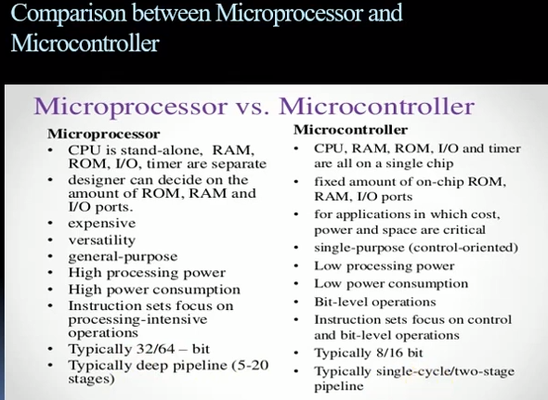

Slide 3
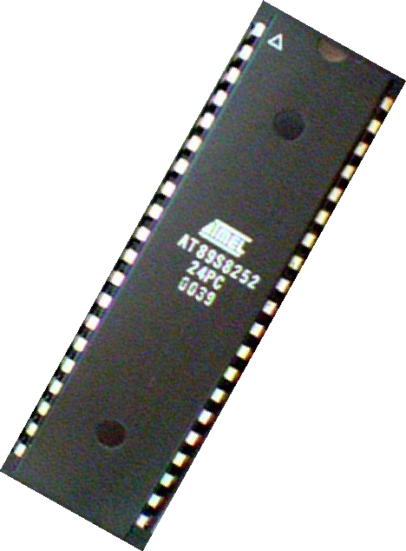
Overview
Introduction
Block Diagram and Pin Description of the 8051
Registers
Memory mapping in 8051 Stack in the 8051
I/O Port Programming
Timers
Interrupts & Applications

Slide 4
Why do we need to learn Microcontrollers ?
Today there is no electronic gadget on the earth which is designed without a Microcontroller. Ex: communication devices, digital entertainment, portable devices etc…

Slide 5
Personal information products: Cell phone, pager, watch, pocket recorder, calculator
Laptop components: mouse, keyboard, modem, fax card, sound card, battery charger
Home appliances: door lock, alarm clock, thermostat, air conditioner, TV remote, VCR, small refrigerator, exercise equipment, washer/dryer, microwave oven
Industrial equipment: Temperature/pressure controllers, Counters, timers, RPM Controllers
Toys: video games, cars, dolls, etc.

Slide 6
Then What is a Microcontroller ?
A smaller computer
On-chip RAM, ROM, I/O ports...
Example ： Motorola’s 6811, Intel’s 8051, Zilog’s Z8 and PIC 16X
A single chip Microcontroller
CPU | RAM | ROM
I/O Port | Timer | Serial COM Port

Slide 7
How is it different from a Microprocessor ??
General-purpose microprocessor
CPU for Computers
No RAM, ROM, I/O on CPU chip itself Example ： Intel’s x86, Motorola’s 680x0
CPU
General- Purpose Micro- processor
Data Bus
I/O
Serial COM
Port
RAM
ROM
Timer
Port
Address Bus

Slide 8
Microprocessor vs. Microcontroller
Microprocessor
CPU is stand-alone, RAM, ROM, I/O, timer are separate
Microcontroller
CPU, RAM, ROM, I/O and timer are all on a single chip
fix amount of on-chip ROM, RAM, I/O ports
Highly bit addressable
for applications in which cost, power and space are critical
single-purpose
designer can decide on the amount of ROM, RAM and I/ O ports.
expansive versatility general-purpose
■
■
■

Slide 9
ARM Controllers
In recent times ARM company (Advanced Risc machines) has developed and introduced 32 bit controllers which are highend application devices,especially communication devices like mobiles , ipods etc..(Refer www.arm.com)

Slide 10
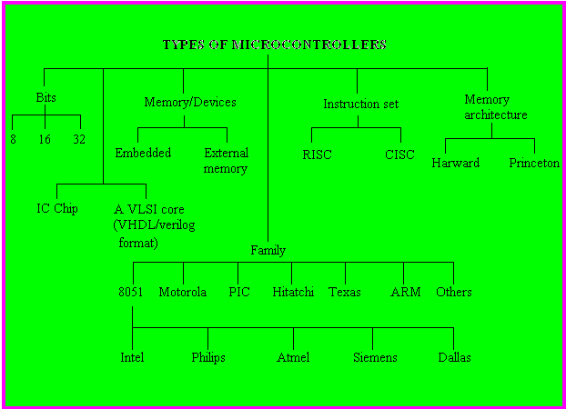
Types of Microcontrollers

Slide 11
MCS-51 “Family” of Microcontollers
Feature
ROM
8031 8051 8052 8751
NO 4kB 8kB 4kB UV Eprom
RAM (Bytes) 128
128
256
128
TIMERS
2
2
3
2
I/O PINS
32
32
32
32
SERIAL PORTS 1
1
1
1
INTERRUPT SOURCES
6
6
8
6

Slide 12
Microcontroller Architectures
Memory
Address Bus ⁰
Program
CPU
+ Data
Von Neumann
Data Bus
Architecture
₂n
Memory
CPU
Address Bus
0
Program
Fetch Bus
Harvard
Architecture
Address Bus
0
Data Bus
Data

Slide 13
In Harvard architecture, the CPU is connected with both the data memory (RAM) and program memory (ROM), separately.
In Von-Neumann architecture, there is no separate data and program memory.
Instead, a single memory connection is given to the CPU. ...
Von-Neumann Architecture requires less space.

Slide 14
Important Features of 8051
4K bytes ROM
128 bytes RAM
Four 8-bit I/O ports
Two 16-bit timers
Serial interface
64K external code memory space
64K data memory space

Slide 15
“Original” 8051 Microcontroller
Oscillator and timing
4096 Bytes Program Memory (ROM)
128 Bytes Data Memory (RAM)
Two 16 Bit Timer/Event Counters
8051
CPU
Internal data bus
64 K Byte Bus Expansion Control
Programmable I/ O
Programmable Serial Port Full Duplex UART Synchronous Shifter
subsystem interrupts
External interrupts
Control
Parallel ports
Serial Output
Address Data Bus
Serial Input
I/O pins

Slide 16
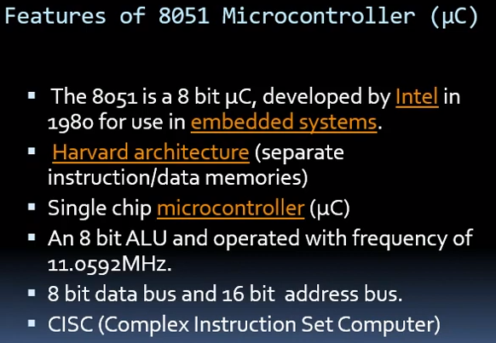

Slide 17
